Slide 1
GROUP 03
SHOES STORE
Instructor: Nguyễn Thiên Bảo
Member:
Trần Phương Nam
Nguyễn Nhiêu Thịnh
Đào Xuân Thắng
Nguyễn Thanh Vy

Slide 2
CONTENT
Project description
Mern Stack
How Mern Stack Work
Famous Shoes Store Website

Slide 3
Objectives The selling shoes website like an e-commerce website that allow users to access and buy shoes. This website we integrate payment methods such as Paypal for users by online payment. The manager can update and manage the product which they provided for user in the website.

Slide 4
2. User benefits - User can pay for their product by online payment. - The UI is easy for the user can use. - Users can read description of shoes to decide whether the shoes they love most. - There is cart that user can store product inside it if they want to buy another pair of shoe or not to buy now.

Slide 5


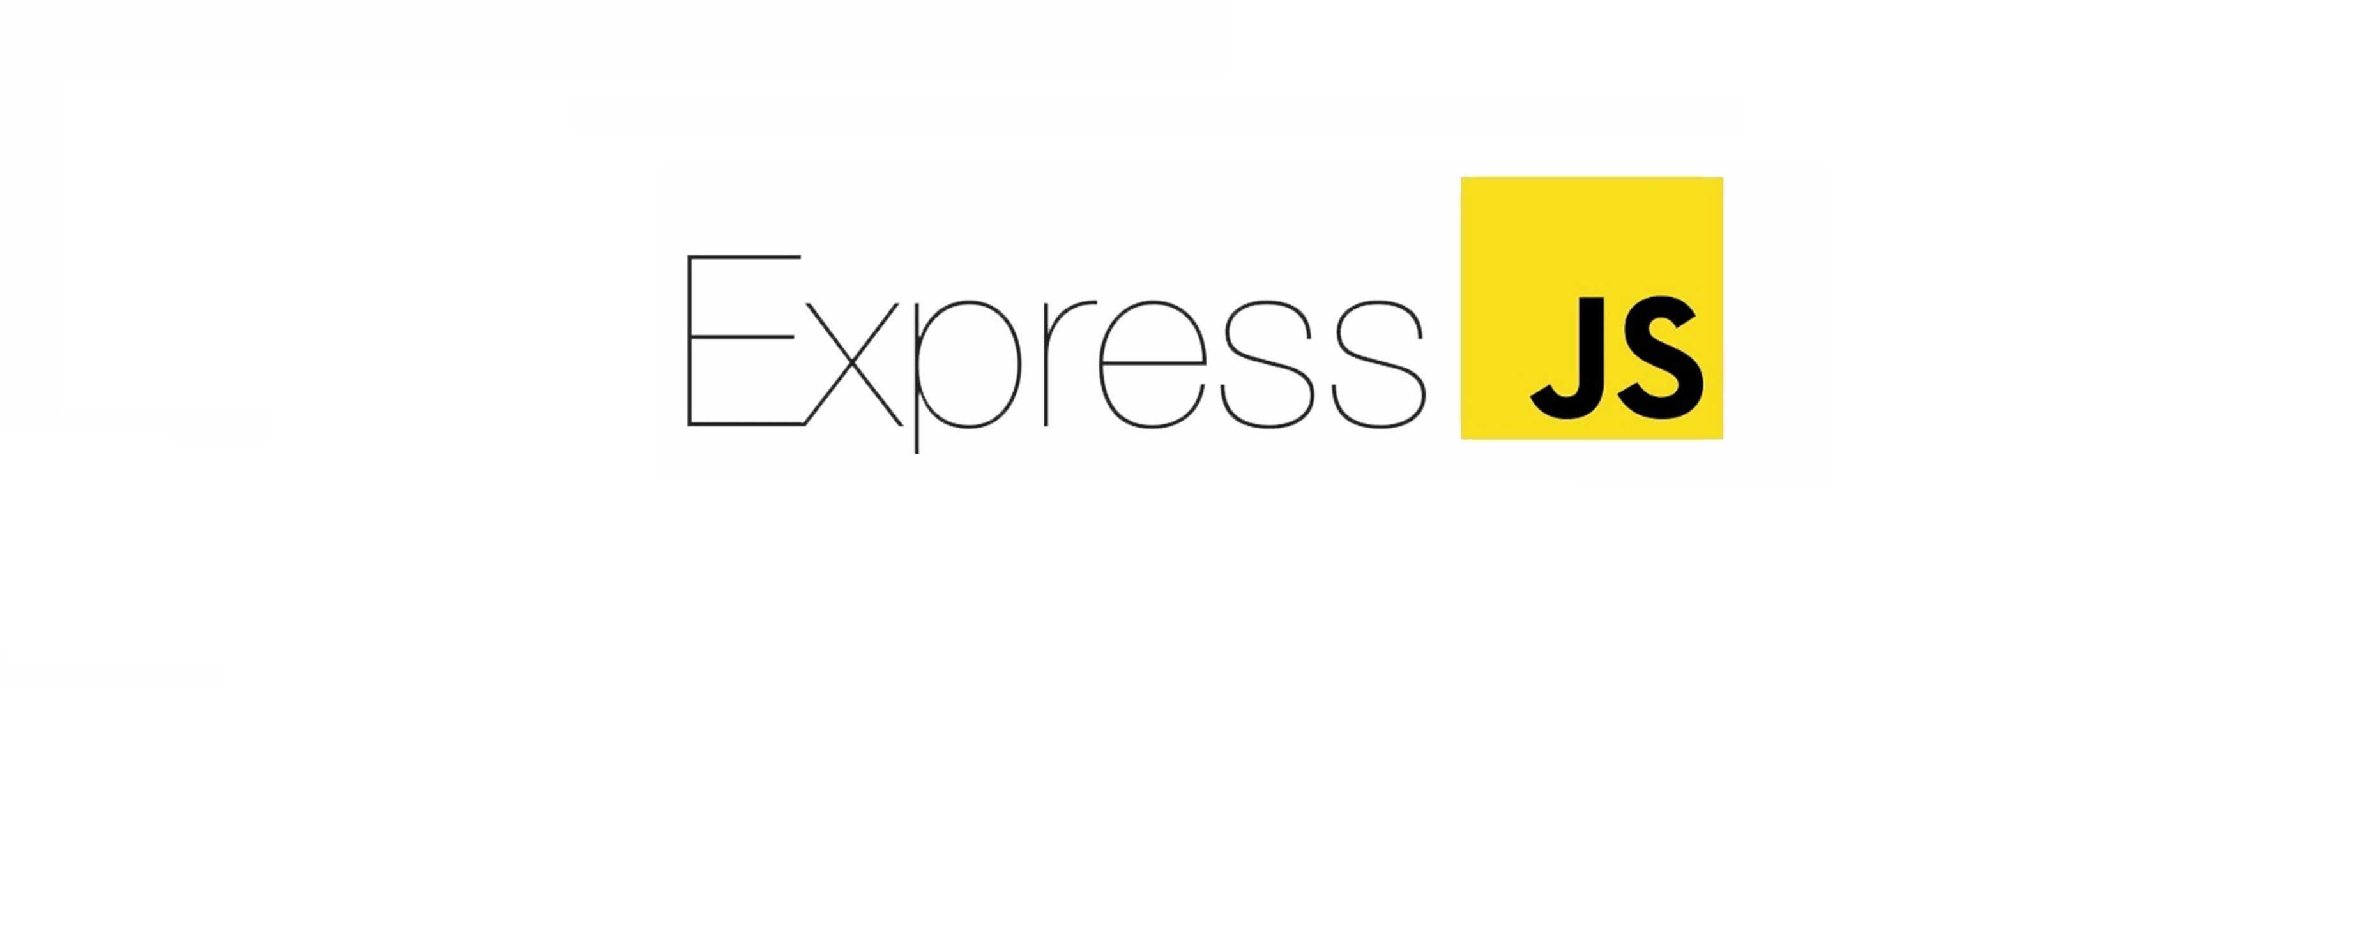
Mern stack
MERN stands for MongoDB, Express, React, Node, after the four key technologies that make up the stack.
MongoDB — document database
Express(.js) — Node.js web framework
React(.js) — a client-side JavaScript framework

Slide 6
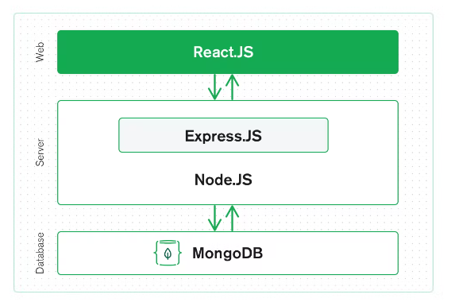
How Mern stack work
Reactjs – frontend
Express.js and Node.js server tier
MongoDB database tier

Slide 7
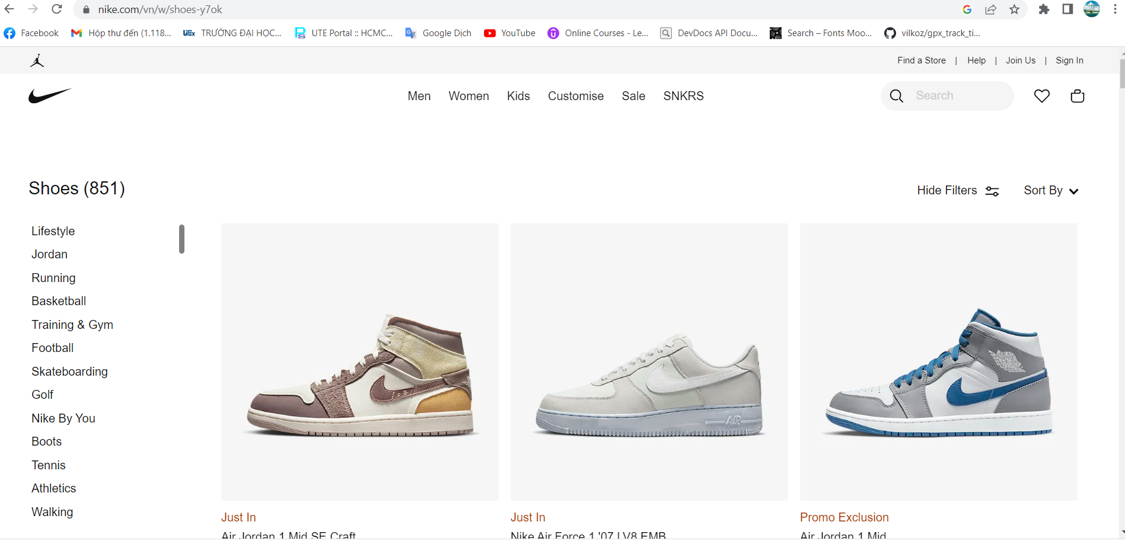
nike.com

Slide 8
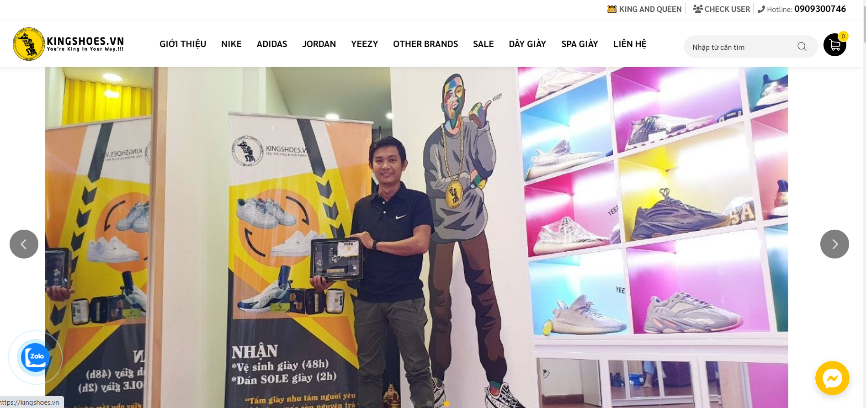
kingshoe.vn

Slide 9
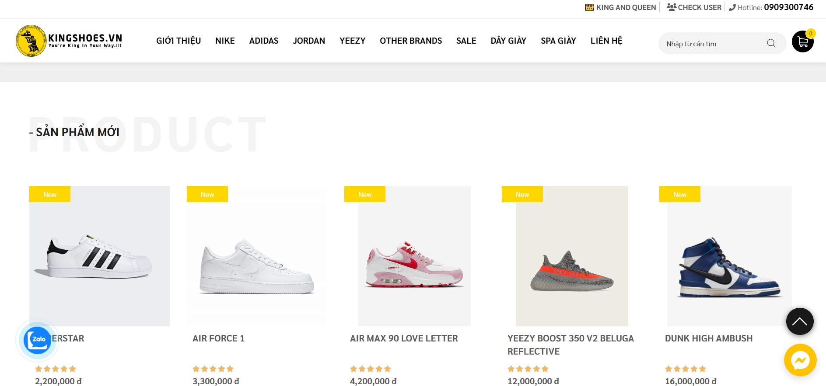
kingshoe.vn

Slide 10
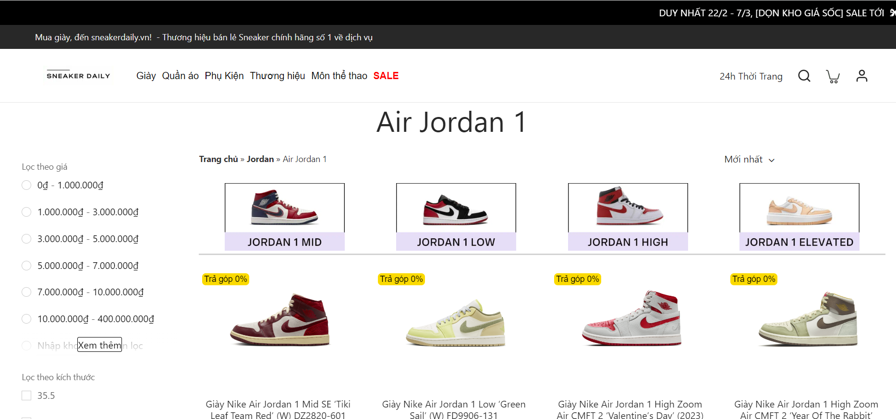
sneakerdaily.vn

Slide 11
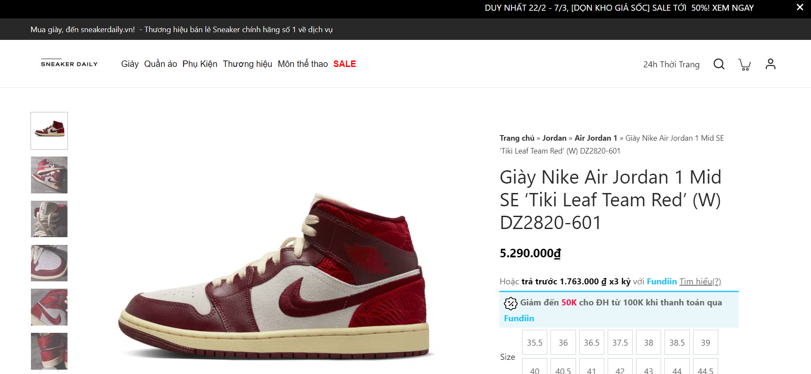
sneakerdaily.vn

Slide 12
THANK YOU

